Slide 1
One-Shot Transfer Learning of Linear Ordinary and Partial Differential Equations
Hari Raval
Advisor: Pavlos Protopapas
Committee: Pavlos Protopapas, Cengiz Pehlevan, Fabian Wermelinger
5/10/23

Slide 2
Outline
Overview and Goals
Background and Motivation
Training & Transfer Learning Components
Ordinary Differential Equations
Partial Differential Equations
Performing One-Shot Transfer Learning
Ordinary Differential Equations
Partial Differential Equations
Results
Ordinary Differential Equations
Partial Differential Equations
Limitations
Future Work
Conclusion
1

Slide 3
Outline
Overview and Goals
Background and Motivation
Training & Transfer Learning Components
Ordinary Differential Equations
Partial Differential Equations
Performing One-Shot Transfer Learning
Ordinary Differential Equations
Partial Differential Equations
Results
Ordinary Differential Equations
Partial Differential Equations
Limitations
Future Work
Conclusion
2

Slide 4
Overview and Goals
Train a Physics Informed Neural Network (PINN) on a system of linear differential equations once with varying conditions
Learn a latent space representation of the equations → H
Find a closed-form representation of generalizable network weights → W₀
Use H and W₀ to transfer learn solutions of equations of the same family:
Equations with new initial conditions → u₀
Equations with new forcing functions → f
Equations with new equation coefficients → A, G
Equations with new time inputs → t
3

Slide 5
Outline
Overview and Goals
Background and Motivation
Training & Transfer Learning Components
Ordinary Differential Equations
Partial Differential Equations
Performing One-Shot Transfer Learning
Ordinary Differential Equations
Partial Differential Equations
Results
Ordinary Differential Equations
Partial Differential Equations
Limitations
Future Work
Conclusion
4

Slide 6
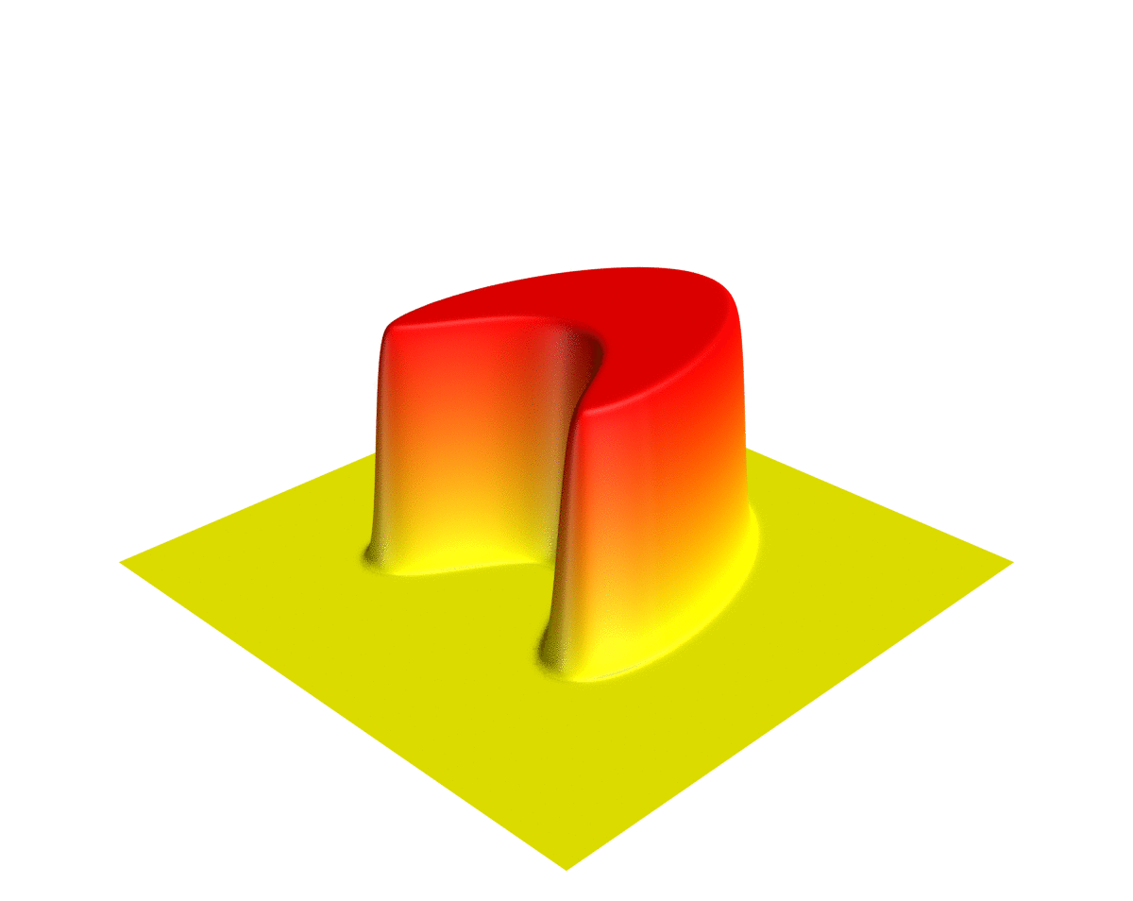
Differential Equations
Differential equations are equations or systems of equations that relate one or more unknown functions and their derivatives
Ordinary differential equations (ODEs)
Partial differential equations (PDEs)
Solving these equations entails uncovering the unknown function(s) that meet the problem criteria:
Satisfy the differential equation
Satisfy the initial and/or boundary conditions
Visualization of a solution to 2D heat equation [Wikipedia]
5

Slide 7
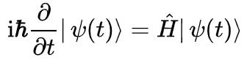
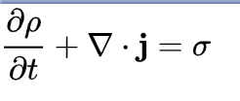
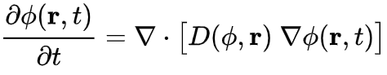
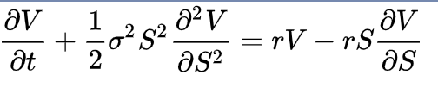
Differential Equations
Efficiently and accurately solving differential equations is essential for progress in many areas of scientific research:
Quantum Mechanics: Schrodinger’s equation | Electromagnetism: Continuity equation
Thermodynamics: Diffusion equation | Economics: Black Scholes equation
6

Slide 8
Differential Equations
Given these equations wide-ranging significance, an extensive amount of research exists in developing intricate numerical methods to solve them
A great deal of interest has recently arisen in using deep learning to solve differential equations
17th Century
Differential equations can be traced back to the creation of calculus
18th & 19th Century
Formulation of methods to solve ordinary differential equations
20th Century
Numerical methods were developed due to the advent of computers
7

Slide 9
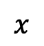
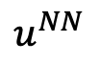
PINNs for Differential Equations
PINNs are neural networks that encode model equations, like ODEs and PDEs, as a part of the network itself
To solve differential equations, we train PINNs on sampled numeric data from a predefined range (no overfitting) and minimize the residual of the equation of interest
To tackle any order or number of equations, a generalized equation representation is necessary
$$x$$
Neural Network
$$u^{NN}$$
8

Slide 10
Benefits of Using PINNs
PINNs | Numerical Methods
Yield differentiable solutions (with appropriate activations) | Yield solutions that are not always differentiable
Provide fast evaluations (forward pass) | Provide slow evaluations sometimes (interpolation)
Require less storage space in most cases (only store weights) | Require more storage space sometimes (store dense mesh grids)
Are parametrizable (parameters as network inputs) | Are not parametrizable (must re-compute if parameters change)
? | Offer solutions that cannot be used for transfer learning (must re-compute for new equations)
9

Slide 11
Benefits of Using PINNs
PINNs | Numerical Methods
Yield differentiable solutions (with appropriate activations) | Yield solutions that are not always differentiable
Provide fast evaluations (forward pass) | Provide slow evaluations sometimes (interpolation)
Require less storage space in most cases (only store weights) | Require more storage space sometimes (store dense mesh grids)
Are parametrizable (parameters as network inputs) | Are not parametrizable (must re-compute if parameters change)
Offer solutions that can be transferred across similar equations | Offer solutions that cannot be used for transfer learning (must re-compute for new equations)
10

Slide 12
Drawbacks of Using PINNs
PINNs | Numerical Methods
Are slow to train | Are fast to compute
Produce difficulties in satisfying boundary conditions on irregular geometries | Produce (usually) no added difficulty in satisfying boundary conditions
Are difficult to tune | Are guaranteed to converge for certain problems
Have no error bound estimation (in general) | Have a known order of error
11

Slide 13
Drawbacks of Using PINNs
PINNs | Numerical Methods
Are slow to train | Are fast to compute
Produce difficulties in satisfying boundary conditions on irregular geometries | Produce (usually) no added difficulty in satisfying boundary conditions
Are difficult to tune | Are guaranteed to converge for certain problems
Have no error bound estimation (in general) | Have a known order of error
12

Slide 14
Outline
Overview and Goals
Background and Motivation
Training & Transfer Learning Components
Ordinary Differential Equations
Partial Differential Equations
Performing One-Shot Transfer Learning
Ordinary Differential Equations
Partial Differential Equations
Results
Ordinary Differential Equations
Partial Differential Equations
Limitations
Future Work
Conclusion
13

Slide 15
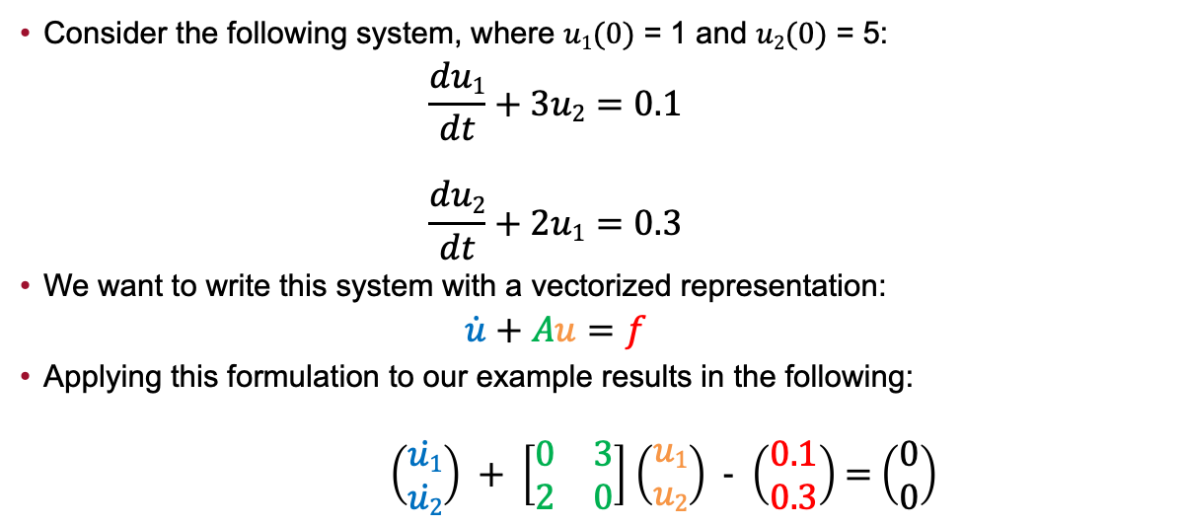
General Equation Representation: ODEs
Consider the following system, where $u1(0)$ = 1 and $u2(0)$ = 5:
$$\frac{du1}{dt}+3u2=0.1$$
$$\frac{du2}{dt}+2u1=0.3$$
We want to write this system with a vectorized representation:
$$\dot{u}+Au=f$$
Applying this formulation to our example results in the following:
$\left(\begin{matrix}\dot{u1} \\ \dot{u2}\end{matrix}\right) + \left[\begin{matrix}0 & 3 \\ 2 & 0\end{matrix}\right]$ $\left(\begin{matrix}u1 \\ u2\end{matrix}\right)$ - $\left(\begin{matrix}0.1 \\ 0.3\end{matrix}\right)$ = $\left(\begin{matrix}0 \\ 0\end{matrix}\right)$
14

Slide 16
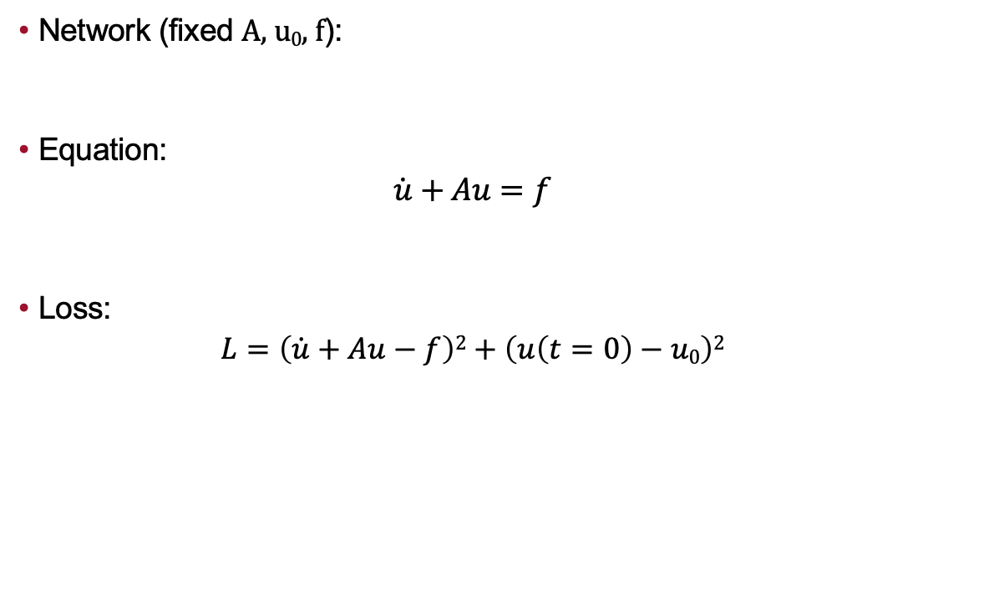
Problem Structure: ODEs
Network (fixed A, u₀, f):
Equation:
$$\dot{u}+Au=f$$
Loss:
$$L=\left(\dot{u}+Au−f\right)2+\left(u\left(t=0\right)−u0\right)2$$
t
Hidden Layers
H
u = HW₀
Output Layer
u ∈ ℝ ^{m x 1}
W₀ ∈ ℝ ^{d x 1}
A ∈ ℝ ^{m x m}
f ∈ ℝ ^{m x 1}
H ∈ ℝ ^{m x d}
Differential Equation
Initial Value
Condition
15

Slide 17
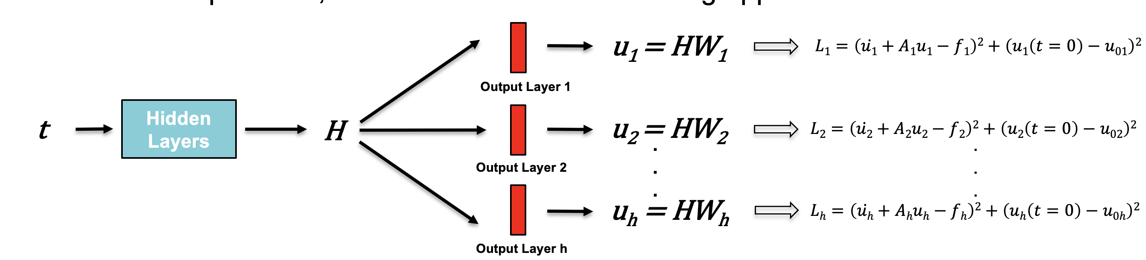
Learning H From Training Procedure: ODEs
To learn H from the training, the network must be sufficiently trained on varying A, f, and u₀ conditions simultaneously
To accomplish this, we use a multi-headed training approach:
.
.
.
16

Slide 18
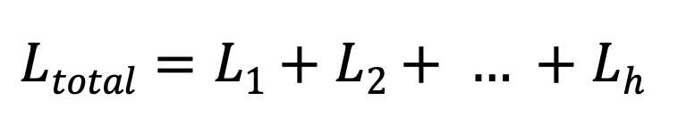
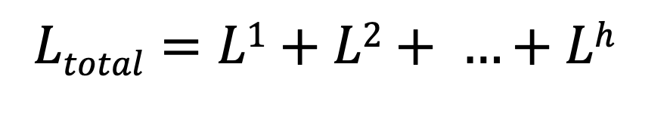
Learning H From Training Procedure: ODEs
To learn H from the training, the network must be sufficiently trained on varying A, f, and u₀ conditions simultaneously
To accomplish this, we use a multi-headed training approach:
.
.
.
17

Slide 19
Learning H From Training Procedure: ODEs
To learn H from the training, the network must be sufficiently trained on varying A, f, and u₀ conditions simultaneously
To accomplish this, we use a multi-headed training approach:
.
.
.
18

Slide 20
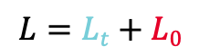
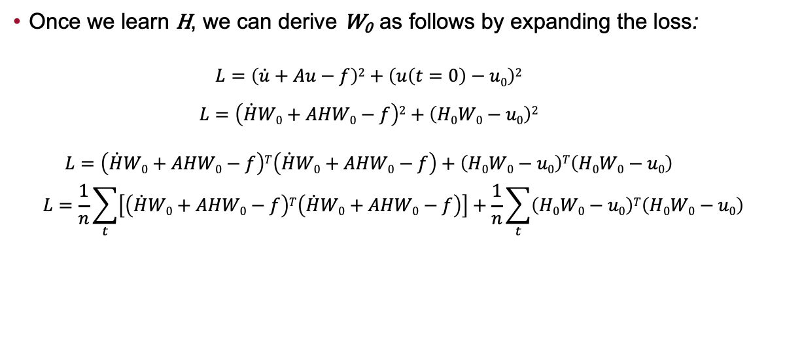
Computing W₀ After Training: ODEs
Once we learn H, we can derive W₀ as follows by expanding the loss:
$$L=\left(\dot{u}+Au−f\right)2+\left(u\left(t=0\right)−u0\right)2$$
$$L=\left(\dot{H}W0+AHW0−f\right)2+\left(H0W0−u0\right)2$$
$$L=\left(\dot{H}W0+AHW0−f\right)T\left(\dot{H}W0+AHW0−f\right)+\left(H0W0−u0\right)T\left(H0W0−u0\right)$$
$$L=\frac{1}{n}\sum_{t}{\left[\left(\dot{H}W0+AHW0−f\right)T\left(\dot{H}W0+AHW0−f\right)\right]}+\frac{1}{n}\sum_{t}{\left(H0W0−u0\right)T\left(H0W0−u0\right)}$$
u = HW₀
multiple t
L_{t}
L₀
$$L=Lt+L0$$
19

Slide 21
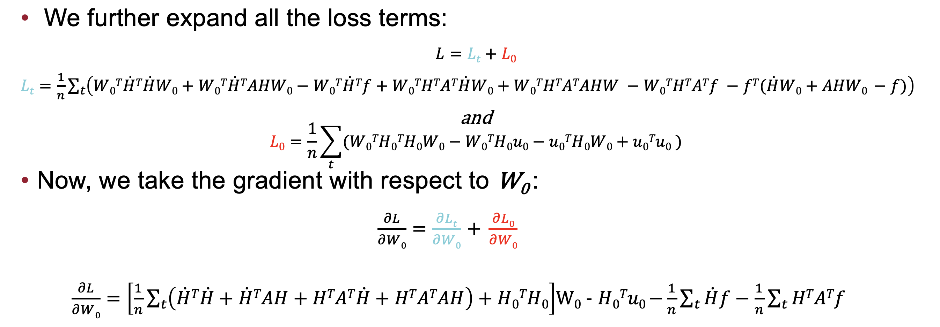
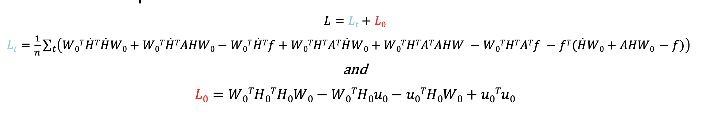
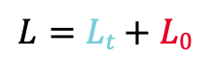
Computing W₀ After Training: ODEs
$$L=Lt+L0$$
20

Slide 22
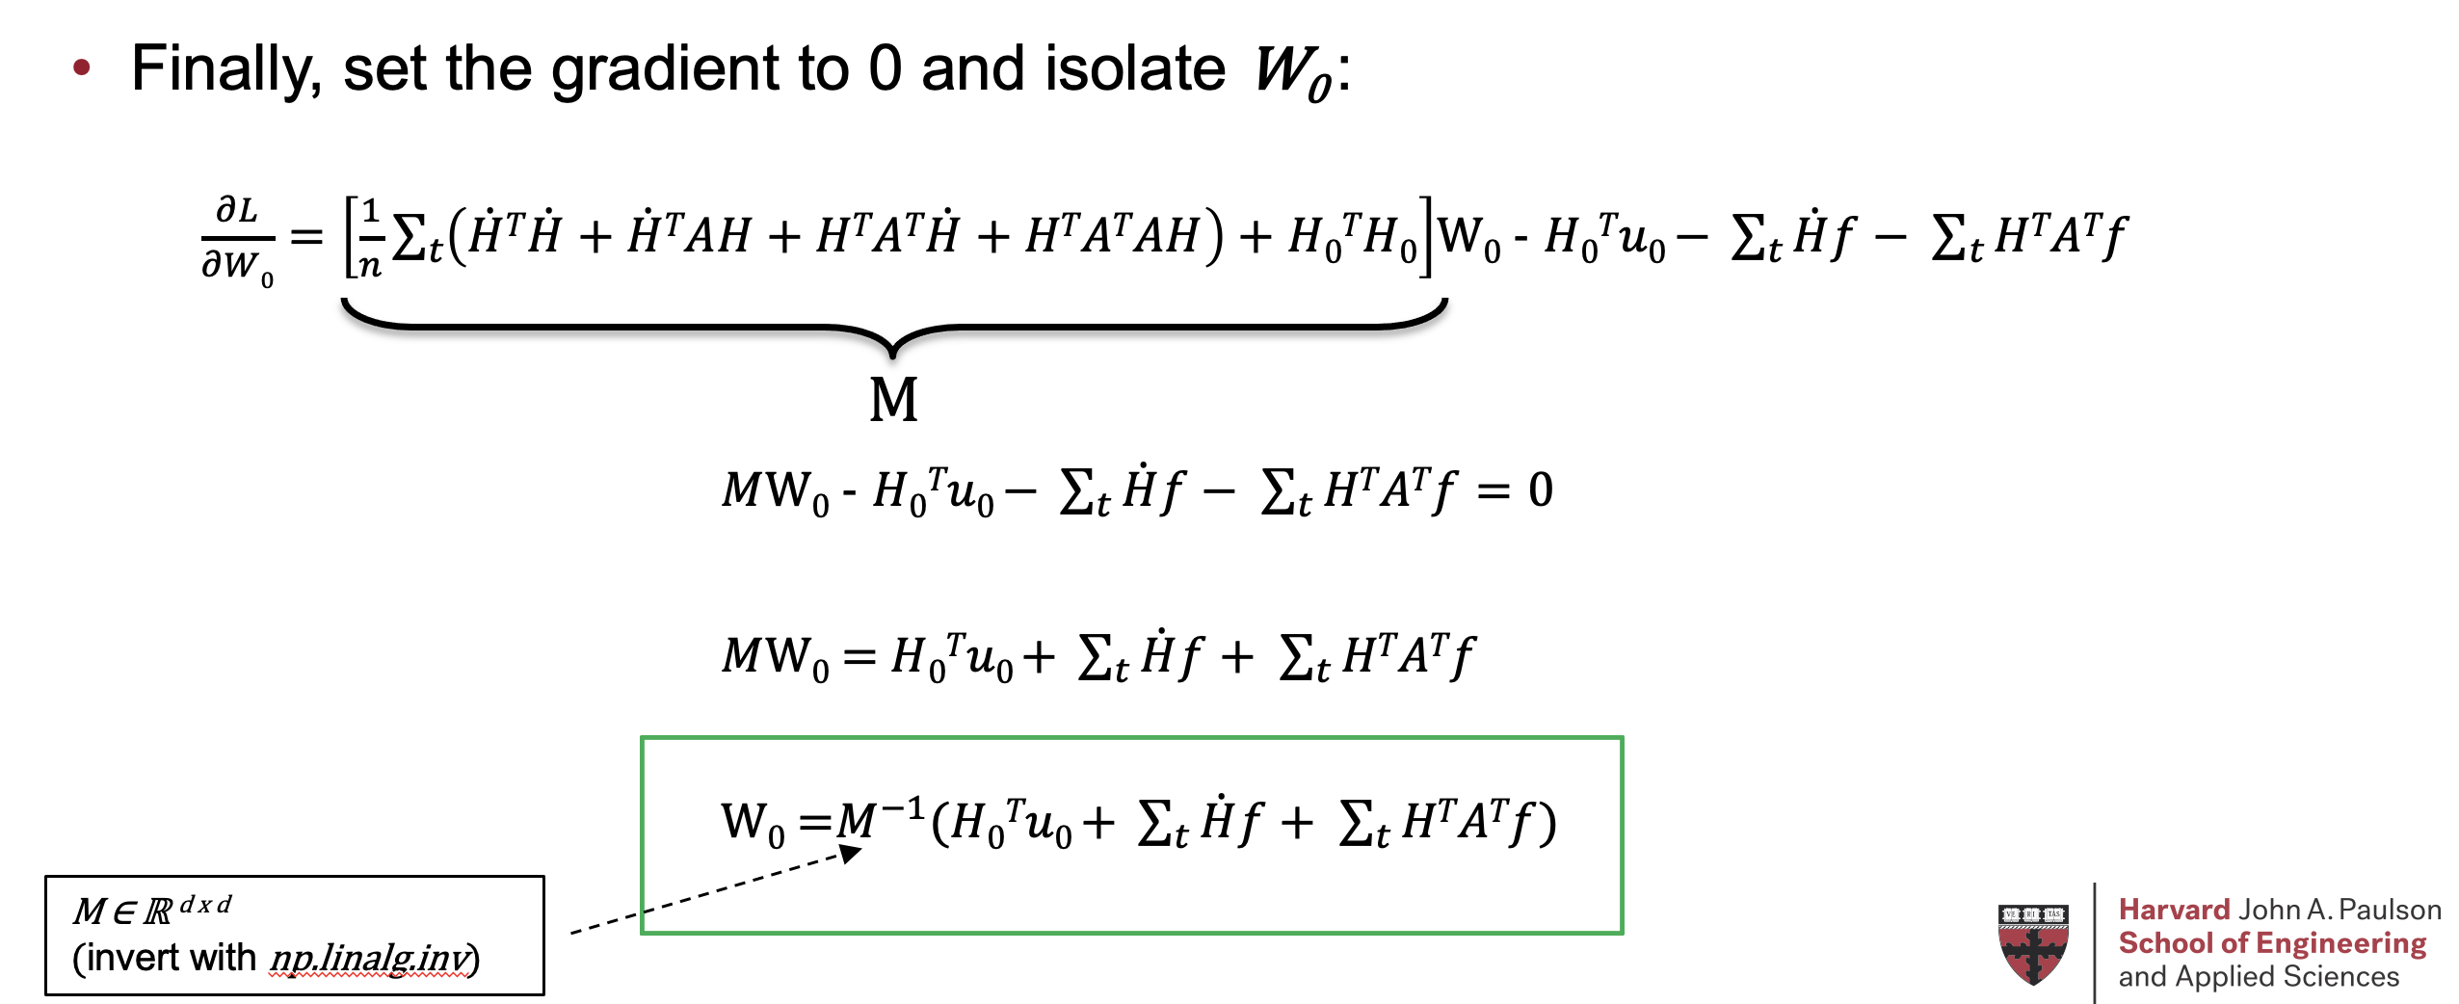
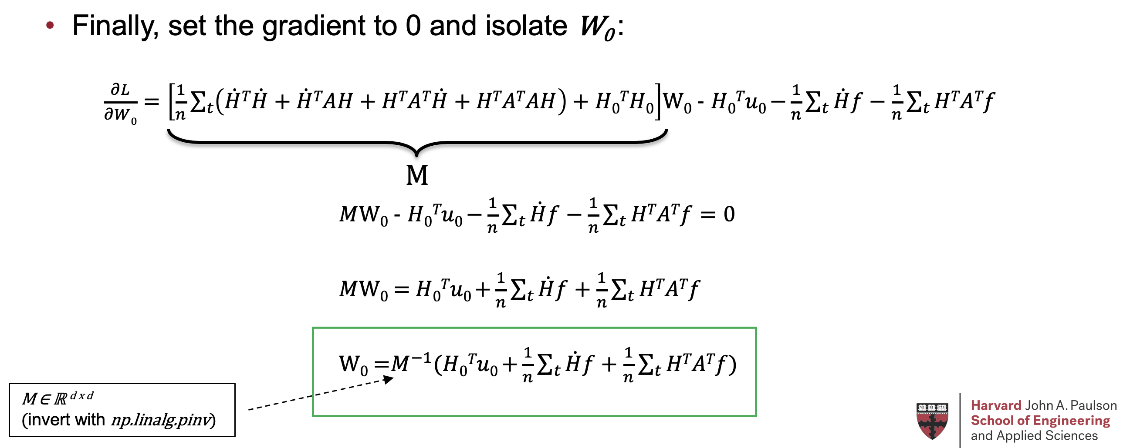
Computing W₀ After Training: ODEs
21

Slide 23
Outline
Overview and Goals
Background and Motivation
Training & Transfer Learning Components
Ordinary Differential Equations
Partial Differential Equations
Performing One-Shot Transfer Learning
Ordinary Differential Equations
Partial Differential Equations
Results
Ordinary Differential Equations
Partial Differential Equations
Limitations
Future Work
Conclusion
22

Slide 24
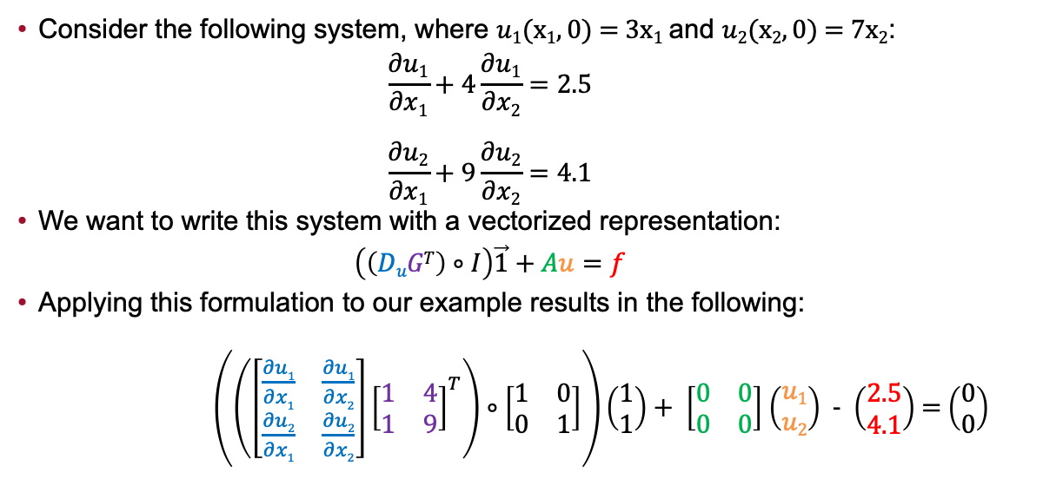
General Equation Representation: PDEs
Consider the following system, where $u1(x1, 0)$ = 3x₁ and $u2(x2, 0)$ = 7x₂:
$$\frac{∂u1}{∂x1}+4\frac{∂u1}{∂x2}=2.5$$
$$\frac{∂u2}{∂x1}+9\frac{∂u2}{∂x2}=4.1$$
We want to write this system with a vectorized representation:
$$\left(\left(DuGT\right)∘I\right)\vec{1}+Au=f$$
Applying this formulation to our example results in the following:
$\left(\left(\left[\begin{matrix}\frac{∂u1}{∂x1} & \frac{∂u1}{∂x2} \\ \frac{∂u2}{∂x1} & \frac{∂u2}{∂x2}\end{matrix}\right]{\left[\begin{matrix}1 & 4 \\ 1 & 9\end{matrix}\right]}^{T}\right)∘\left[\begin{matrix}1 & 0 \\ 0 & 1\end{matrix}\right]\right)\left(\begin{matrix}1 \\ 1\end{matrix}\right)+ \left[\begin{matrix}0 & 0 \\ 0 & 0\end{matrix}\right]$ $\left(\begin{matrix}u1 \\ u2\end{matrix}\right)$ - $\left(\begin{matrix}2.5 \\ 4.1\end{matrix}\right)$ = $\left(\begin{matrix}0 \\ 0\end{matrix}\right)$
23

Slide 25
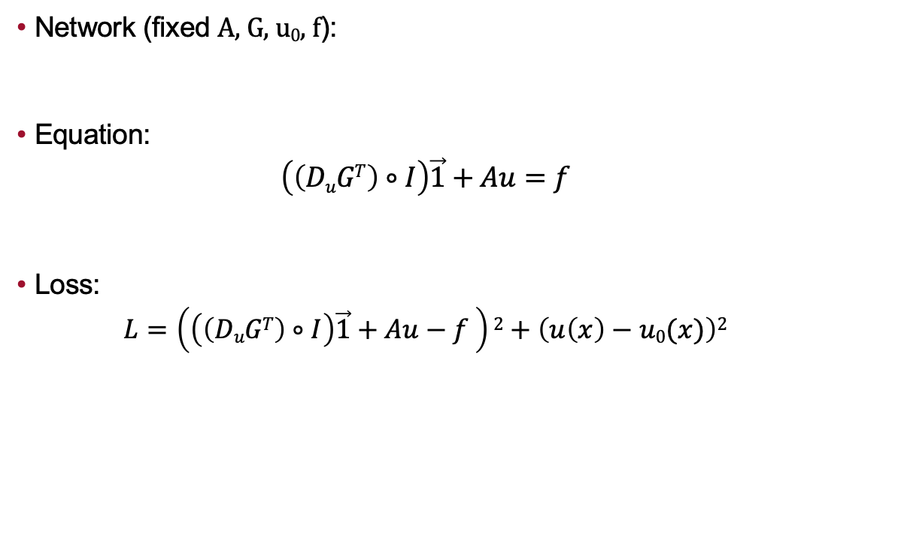
Problem Structure: PDEs
Network (fixed A, G, u₀, f):
Equation:
$$\left(\left(DuGT\right)∘I\right)\vec{1}+Au=f$$
Loss:
$$L=\left(\left(\left(DuGT\right)∘I\right)\vec{1}+Au−f \right)2+\left(u\left(x\right)−u0(x)\right)2$$
x₁
.
.
.
Hidden Layers
H
u = HW₀
x_{n}
Output Layer
u ∈ ℝ ^{m x 1}
W₀ ∈ ℝ ^{d x 1}
H ∈ ℝ ^{m x d}
D_{u} ∈ ℝ ^{m x n}
G ∈ ℝ ^{m x n}
A ∈ ℝ ^{m x m}
f ∈ ℝ ^{m x 1}
Differential Equation
Boundary
Condition
24

Slide 26
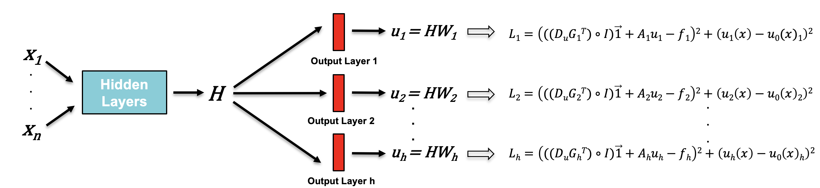
Learning H From Training Procedure: PDEs
To learn H from the training, the network must be sufficiently trained on varying A, G, f, and u₀ conditions simultaneously
To accomplish this, we use a multi-headed training approach:
25

Slide 27
Learning H From Training Procedure: PDEs
To learn H from the training, the network must be sufficiently trained on varying A, G, f, and u₀ conditions simultaneously
To accomplish this, we use a multi-headed training approach:
26

Slide 28
Learning H From Training Procedure: PDEs
To learn H from the training, the network must be sufficiently trained on varying A, G, f, and u₀ conditions simultaneously
To accomplish this, we use a multi-headed training approach:
27

Slide 29
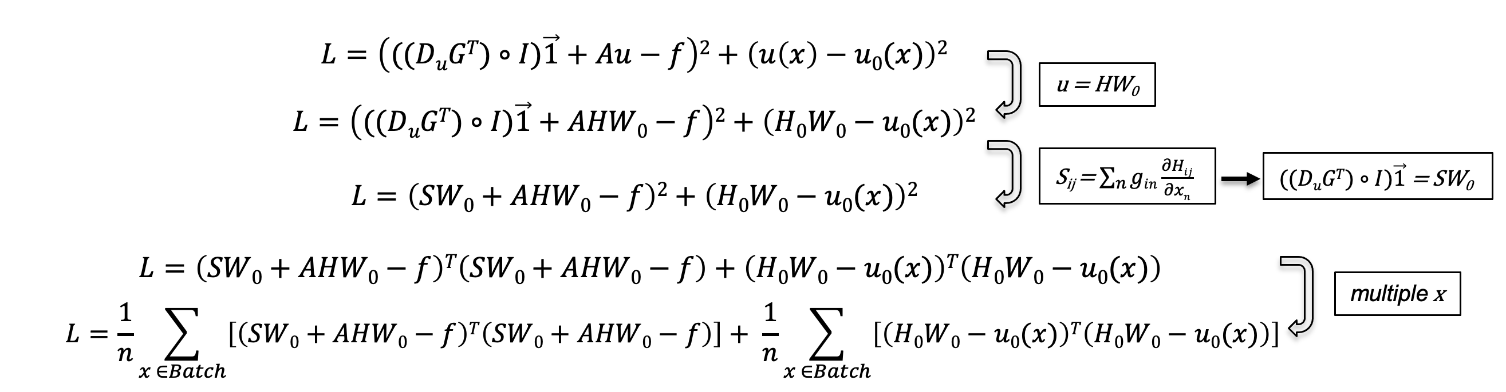
Computing W₀ After Training: PDEs
Once we learn H, we can derive W₀ as follows by expanding the loss:
L_{x}
L₀
$$L=Lx+L0$$
28

Slide 30
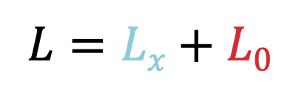
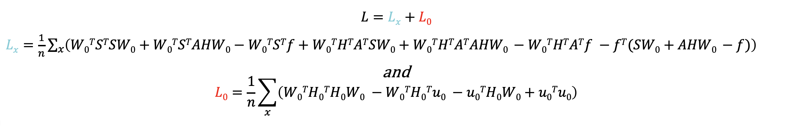
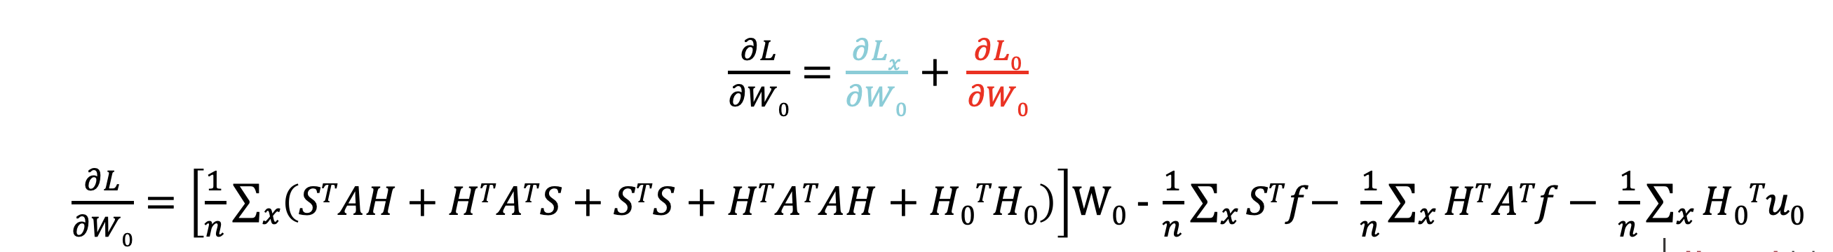
Computing W₀ After Training: PDEs
We further expand all the loss terms:
Now, we take the gradient with respect to W₀ :
29

Slide 31
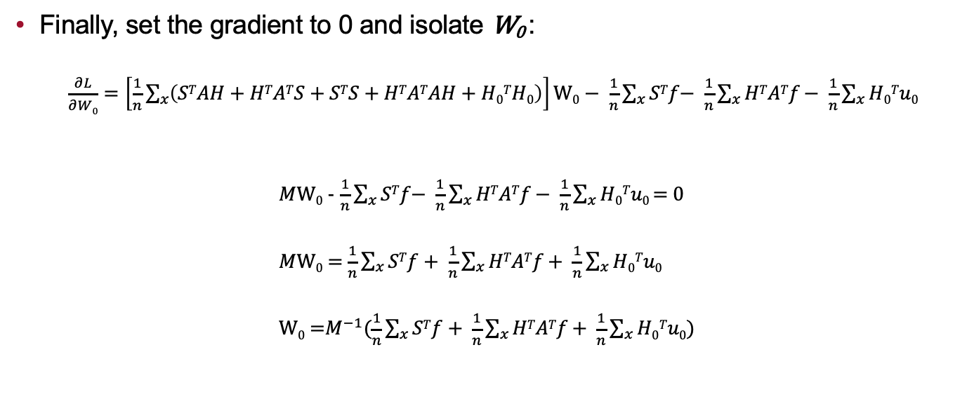
Computing W₀ After Training: PDEs
Finally, set the gradient to 0 and isolate W₀ :
$\frac{∂L}{∂W0}=\left[\frac{1}{n}\sum_{x}{\left(STAH+HTATS+STS+HTATAH+H0TH0\right)}\right]\text{W}\text{0}\text{ −} \frac{1}{n}\sum_{x}{STf\text{−} \frac{1}{n}\sum_{x}{HTATf}\text{−} \frac{1}{n}\sum_{x}{H0Tu0}}$
$M$W₀ - $\frac{1}{n}\sum_{x}{STf\text{−} \frac{1}{n}\sum_{x}{HTATf}\text{−} \frac{1}{n}\sum_{x}{H0Tu0}}$ = 0
$M$W₀ = $\frac{1}{n}\sum_{x}{STf \text{+} \frac{1}{n}\sum_{x}{HTATf}\text{+} \frac{1}{n}\sum_{x}{H0Tu0}}$
W₀ =$M^{−1}(\frac{1}{n}\sum_{x}{STf \text{+} \frac{1}{n}\sum_{x}{HTATf}\text{+} \frac{1}{n}\sum_{x}{H0Tu0)}}$
M
M ∈ ℝ ^{d x d}
(invert with np.linalg.pinv)
30

Slide 32
Outline
Overview and Goals
Background and Motivation
Training & Transfer Learning Components
Ordinary Differential Equations
Partial Differential Equations
Performing One-Shot Transfer Learning
Ordinary Differential Equations
Partial Differential Equations
Results
Ordinary Differential Equations
Partial Differential Equations
Limitations
Future Work
Conclusion
31

Slide 33
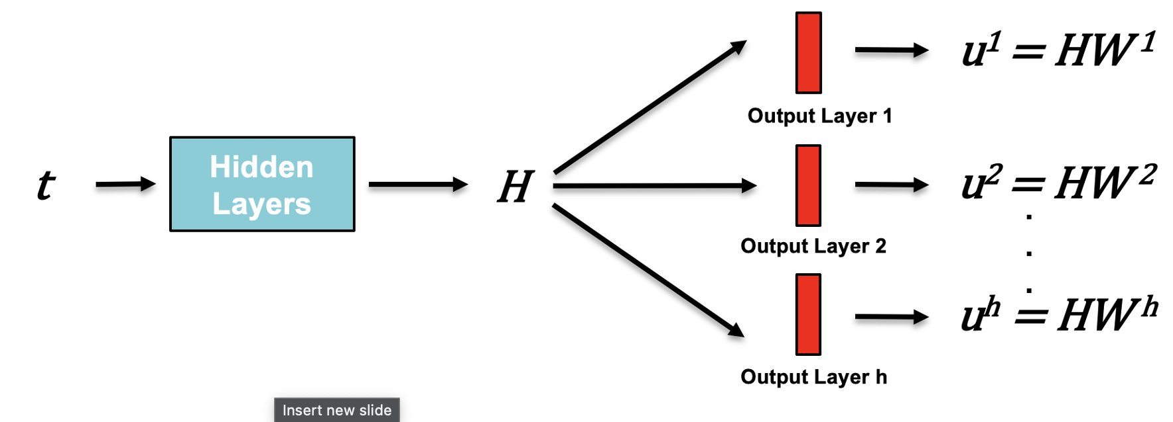
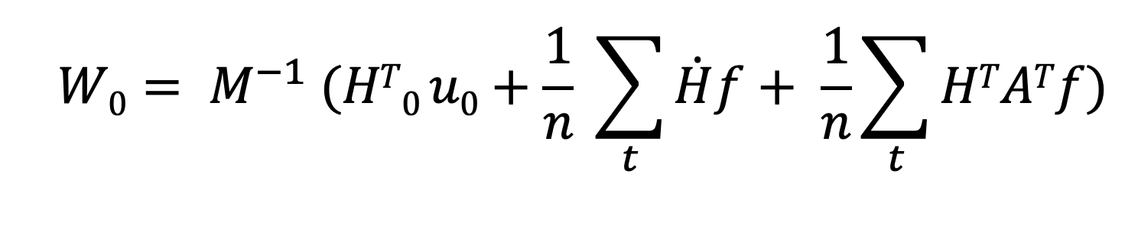
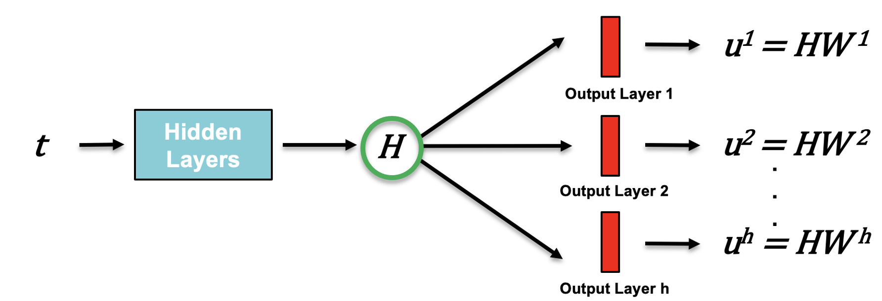
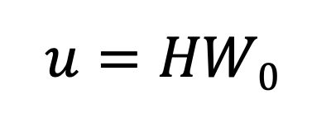
Performing One-Shot Transfer Learning: ODEs
Train a multi-headed network on a system with varying training conditions
Complete a forward pass through the trained network to save H
Compute W₀ for desired values of u₀, A, and f
Calculate the solution u in one-shot by multiplying H with W₀
32

Slide 34
Outline
Overview and Goals
Background and Motivation
Training & Transfer Learning Components
Ordinary Differential Equations
Partial Differential Equations
Performing One-Shot Transfer Learning
Ordinary Differential Equations
Partial Differential Equations
Results
Ordinary Differential Equations
Partial Differential Equations
Limitations
Future Work
Conclusion
33

Slide 35
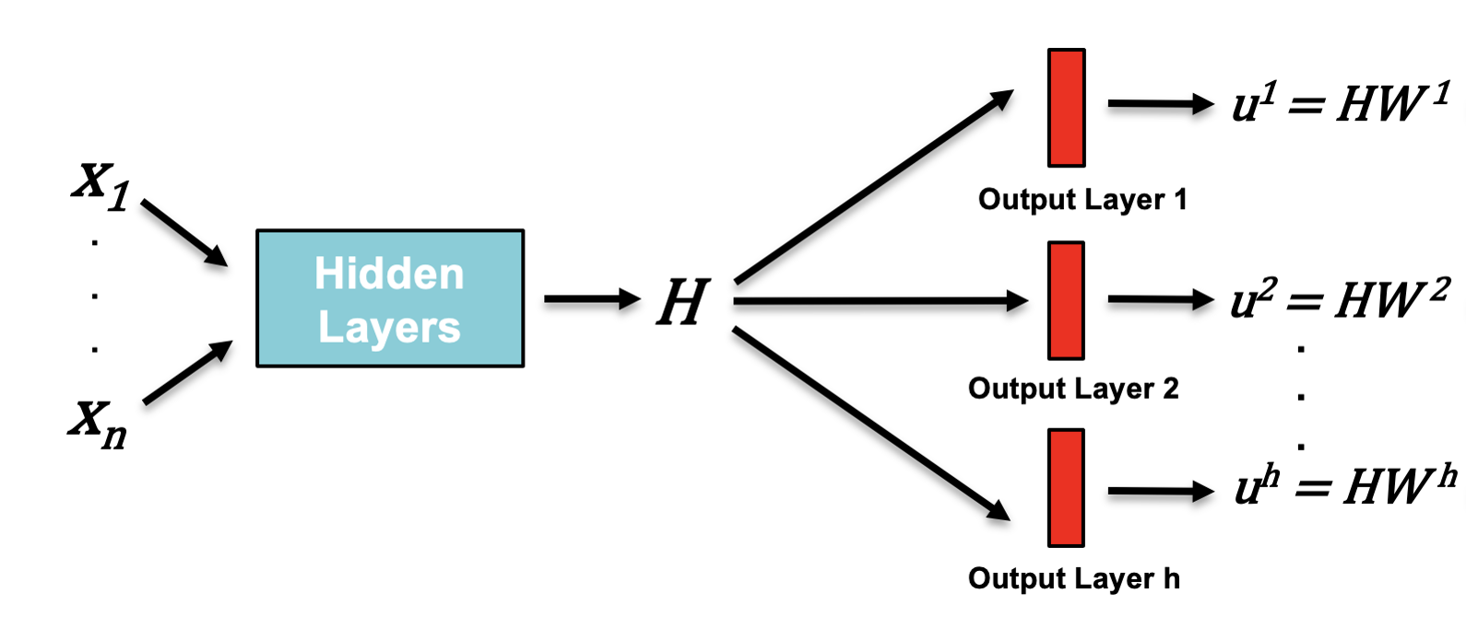
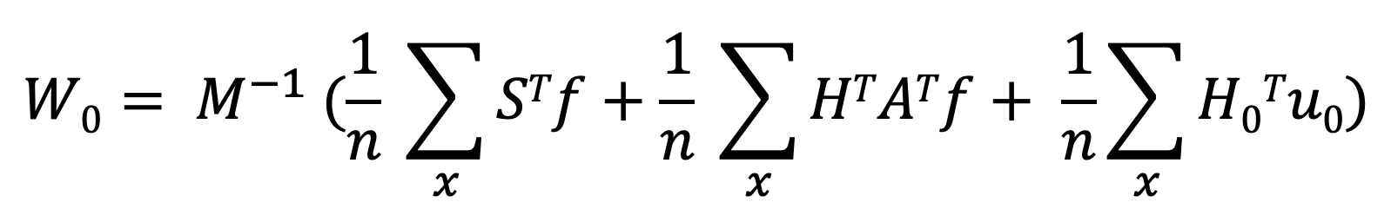
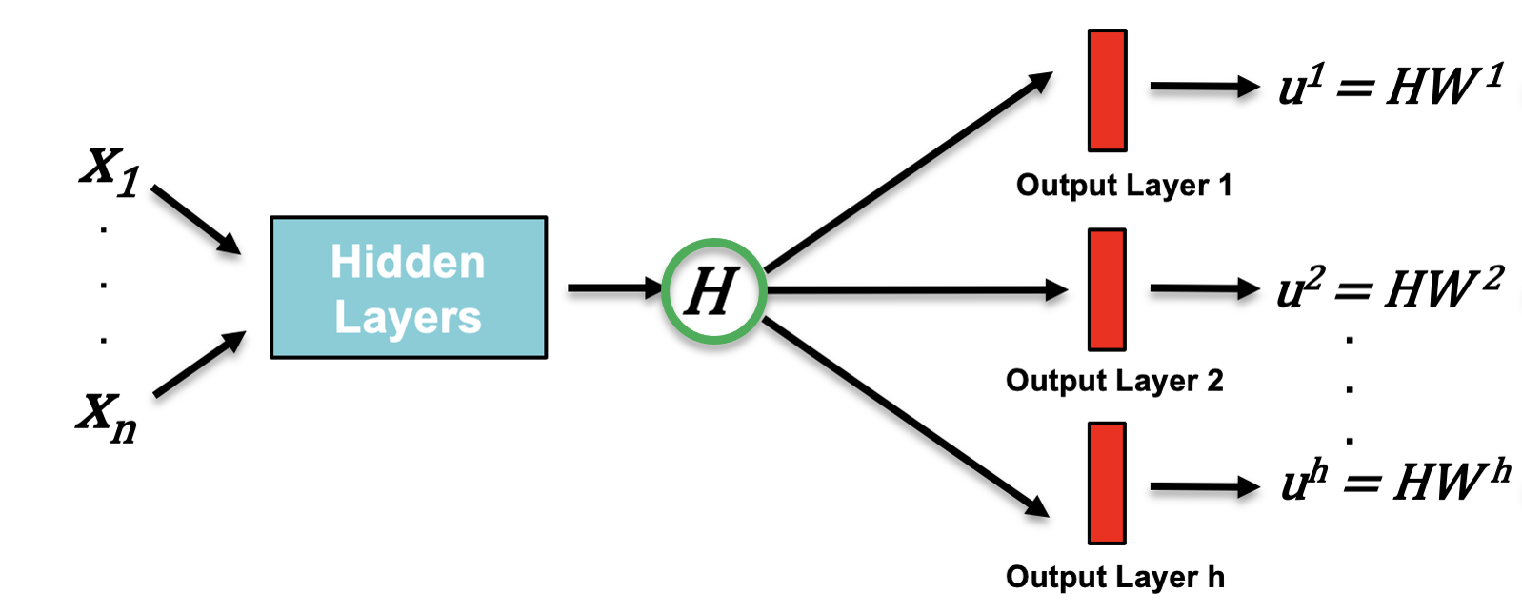
Performing One-Shot Transfer Learning: PDEs
Train a multi-headed network on a system with varying training conditions
Complete a forward pass through the trained network to save H
Compute W₀ for desired values of u₀, A, G, and f
Calculate the solution u in one-shot by multiplying H with W₀
34

Slide 36
Outline
Overview and Goals
Background and Motivation
Training & Transfer Learning Components
Ordinary Differential Equations
Partial Differential Equations
Performing One-Shot Transfer Learning
Ordinary Differential Equations
Partial Differential Equations
Results
Ordinary Differential Equations
Partial Differential Equations
Limitations
Future Work
Conclusion
35

Slide 37
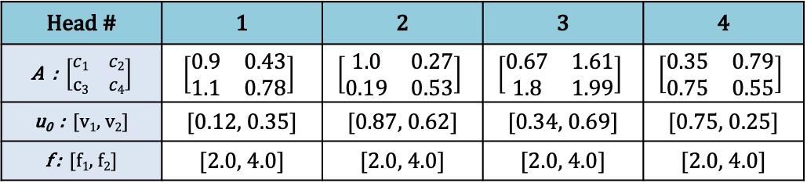
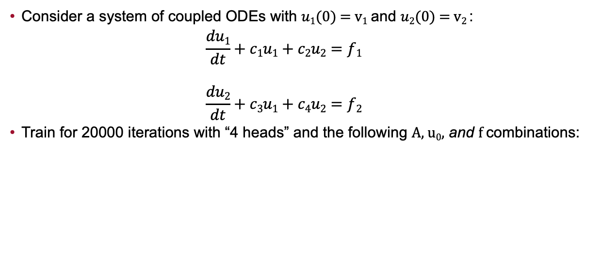
Example 1 - System of Coupled Equations: ODEs
Consider a system of coupled ODEs with $u1(0)$ = v₁ and $u2(0)$ = v₂ :
$$\frac{du1}{dt}+c1u1+c2u2=f1$$
$$\frac{du2}{dt}+c3u1+c4u2=f2$$
Train for 20000 iterations with “4 heads” and the following A, u₀, and f combinations:
Head # | 1 | 2 | 3 | 4
A : $\left[\begin{matrix}c1 & c2 \\ c3 & c4\end{matrix}\right]$ | $$\left[\begin{matrix}0.9 & 0.43 \\ 1.1 & 0.78\end{matrix}\right]$$ | $$\left[\begin{matrix}1.0 & 0.27 \\ 0.19 & 0.53\end{matrix}\right]$$ | $$\left[\begin{matrix}0.67 & 1.61 \\ 1.8 & 1.99\end{matrix}\right]$$ | $$\left[\begin{matrix}0.35 & 0.79 \\ 0.75 & 0.55\end{matrix}\right]$$
u₀ : [v₁, v₂] | [0.12, 0.35] | [0.87, 0.62] | [0.34, 0.69] | [0.75, 0.25]
f : [f₁, f₂] | [2.0, 4.0] | [2.0, 4.0] | [2.0, 4.0] | [2.0, 4.0]
36

Slide 38
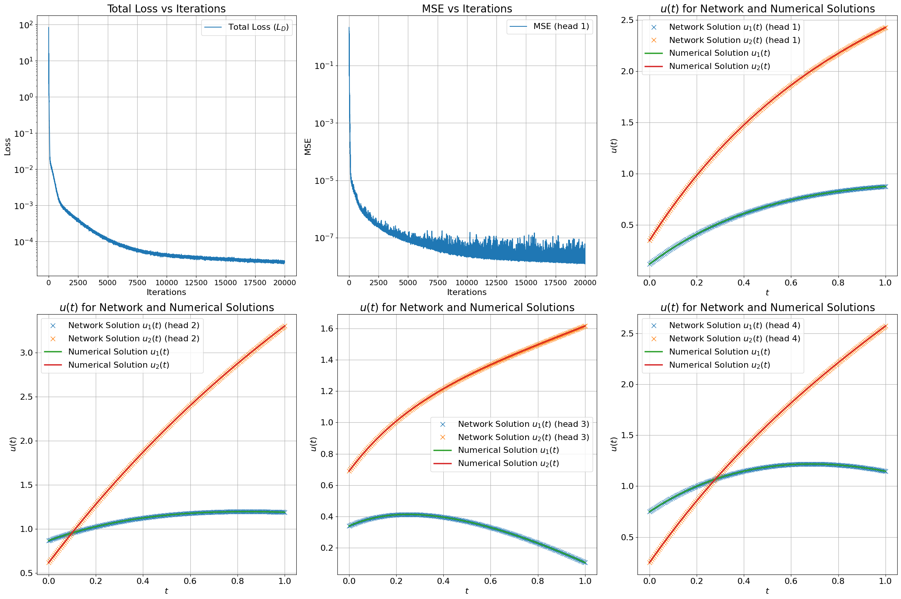
Example 1 - System of Coupled Equations: ODEs
After training, we examine the loss, mean squared error, and solution curves:
1
2
3
[1] Training Loss - differential equation residuals
[2] MSE - average of the square of the difference between network and numerical solutions
3
3
3
[3] Solution Curves - comparison between network versus numerical solutions from training
37

Slide 39
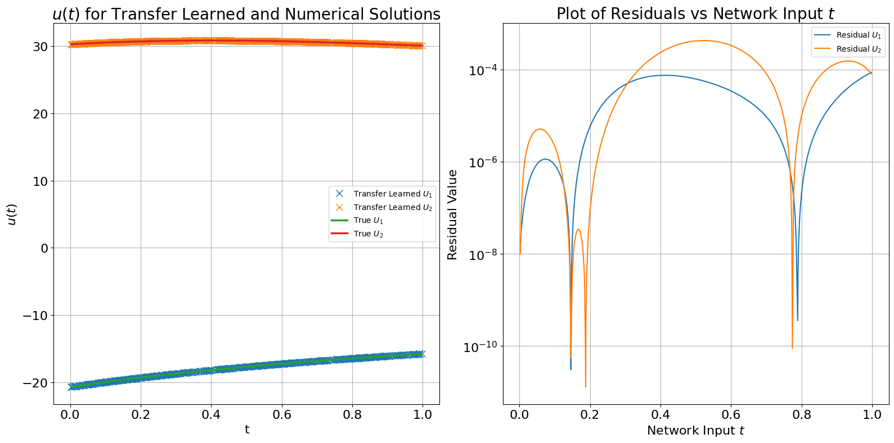
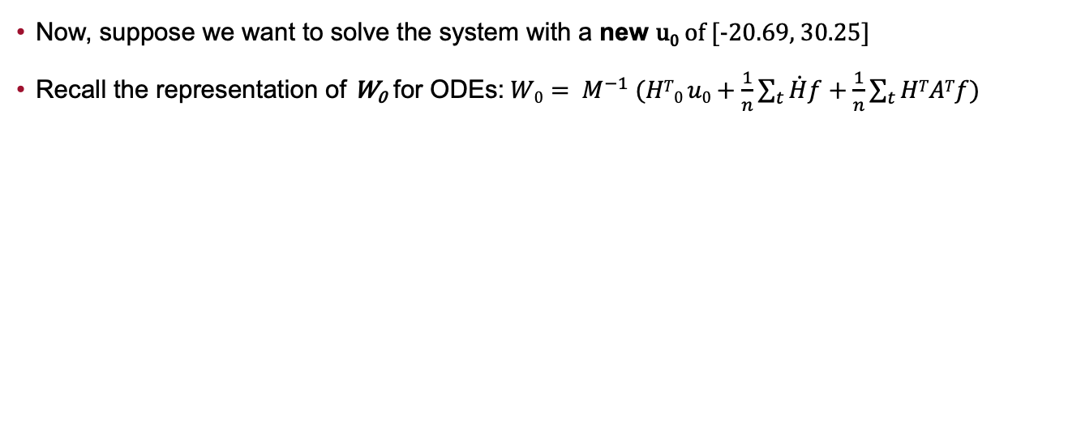
Example 1 - System of Coupled Equations: ODEs
Now, suppose we want to solve the system with a new u₀ of [-20.69, 30.25]
Recall the representation of W₀ for ODEs:$W0= M^{−1} (HT0 u0+\frac{1}{n}\sum_{t}{\dot{H}f+\frac{1}{n}\sum_{t}{HTATf)}}$
38

Slide 40
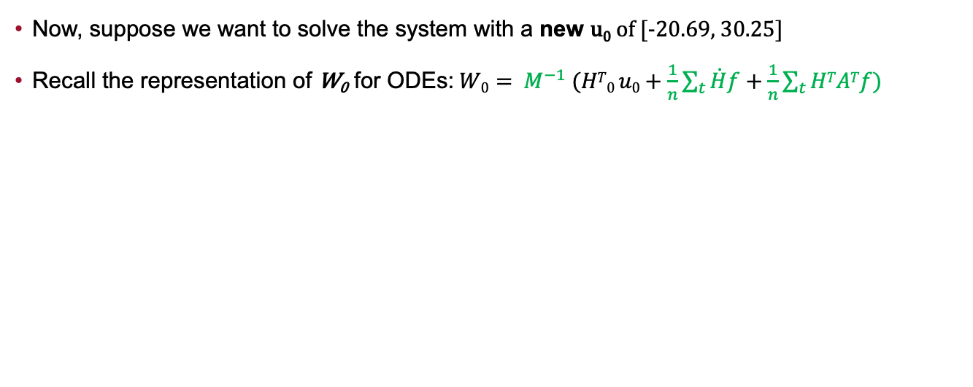
Example 1 - System of Coupled Equations: ODEs
Now, suppose we want to solve the system with a new u₀ of [-20.69, 30.25]
Recall the representation of W₀ for ODEs:$W0= M^{−1} (HT0 u0+\frac{1}{n}\sum_{t}{\dot{H}f+\frac{1}{n}\sum_{t}{HTATf)}}$
= Saved
= Change
39

Slide 41
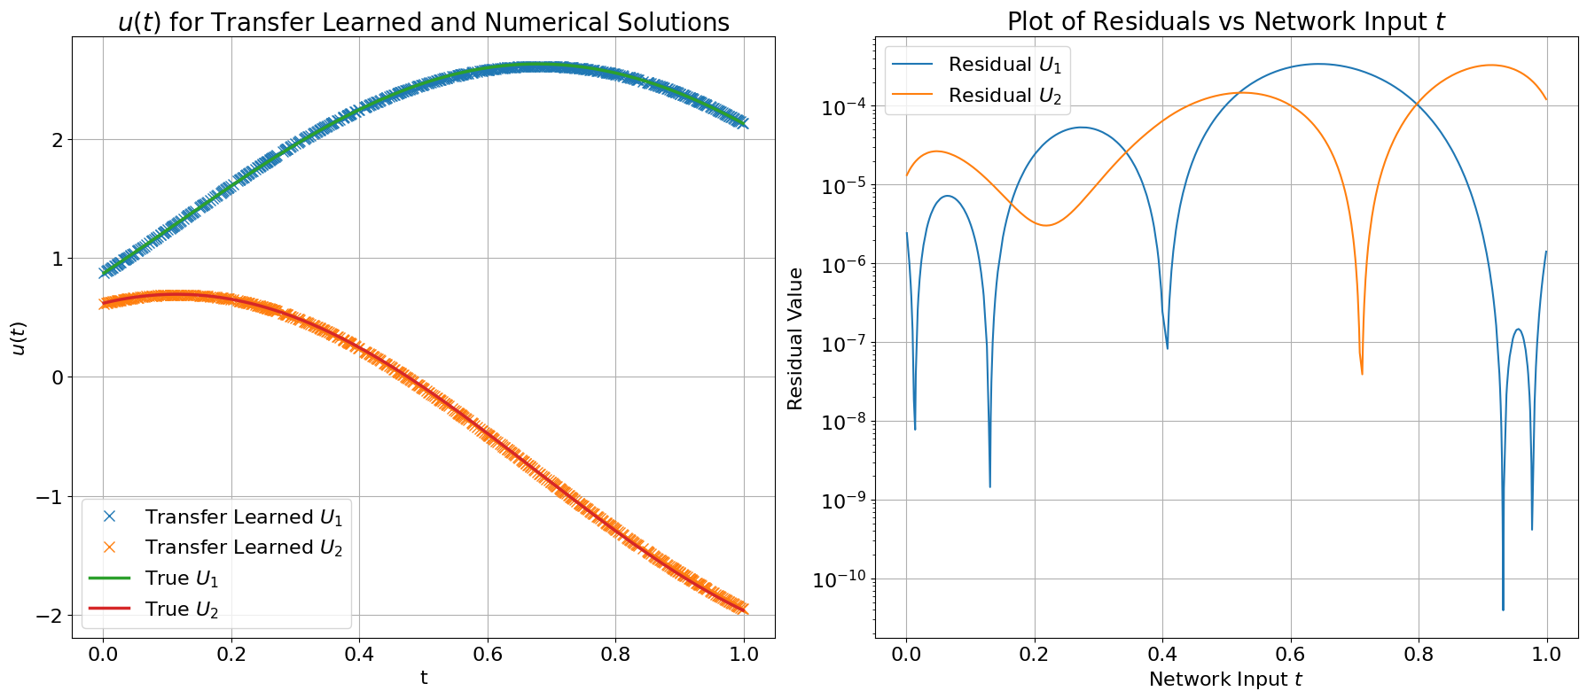
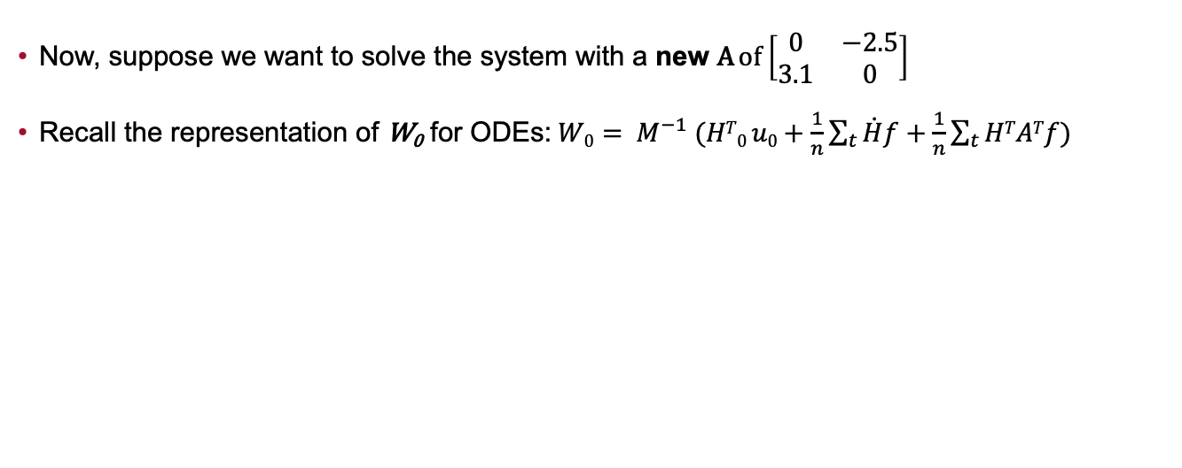
Example 1 - System of Coupled Equations: ODEs
Now, suppose we want to solve the system with a new A of $\left[\begin{matrix}0 & −2.5 \\ 3.1 & 0\end{matrix}\right]$
Recall the representation of W₀ for ODEs:$W0= M^{−1} (HT0 u0+\frac{1}{n}\sum_{t}{\dot{H}f+\frac{1}{n}\sum_{t}{HTATf)}}$
40

Slide 42
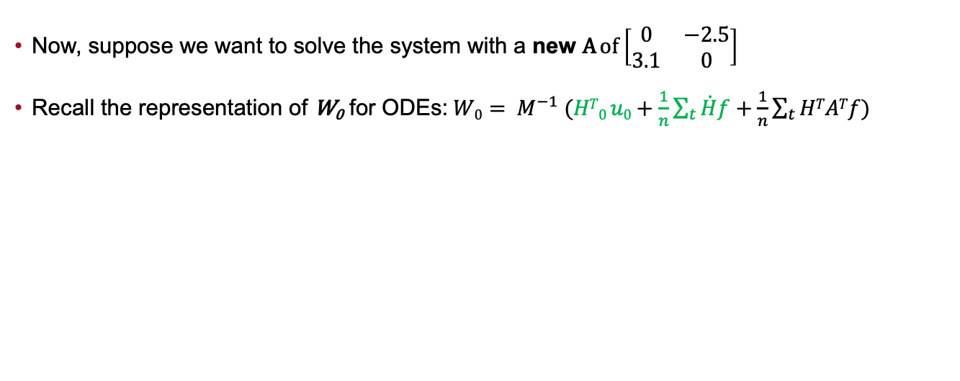
Example 1 - System of Coupled Equations: ODEs
Now, suppose we want to solve the system with a new A of $\left[\begin{matrix}0 & −2.5 \\ 3.1 & 0\end{matrix}\right]$
Recall the representation of W₀ for ODEs:$W0= M^{−1} (HT0 u0+\frac{1}{n}\sum_{t}{\dot{H}f+\frac{1}{n}\sum_{t}{HTATf)}}$
= Saved
= Change
41

Slide 43
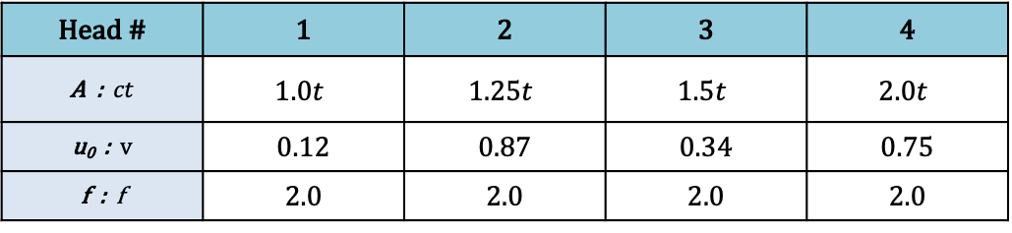
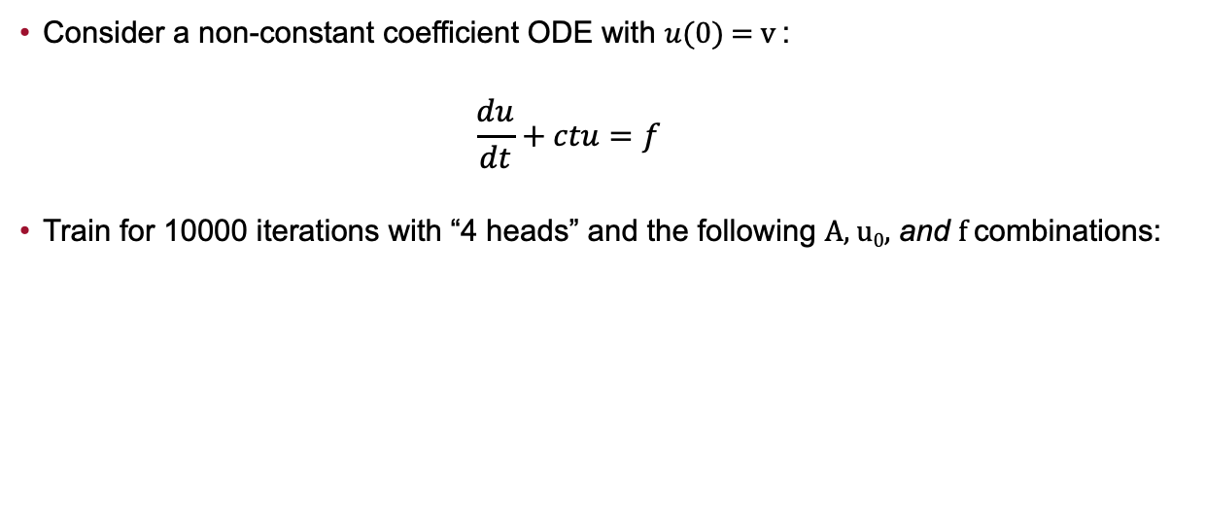
Example 2 - Non-constant Coefficient Equation: ODEs
Consider a non-constant coefficient ODE with $u(0)$ = v :
$$\frac{du}{dt}+ctu=f$$
Train for 10000 iterations with “4 heads” and the following A, u₀, and f combinations:
Head # | 1 | 2 | 3 | 4
A : $ct$ | $$1.0t$$ | $$1.25t$$ | $$1.5t$$ | $$2.0t$$
u₀ : v | 0.12 | 0.87 | 0.34 | 0.75
f : f | 2.0 | 2.0 | 2.0 | 2.0
42

Slide 44
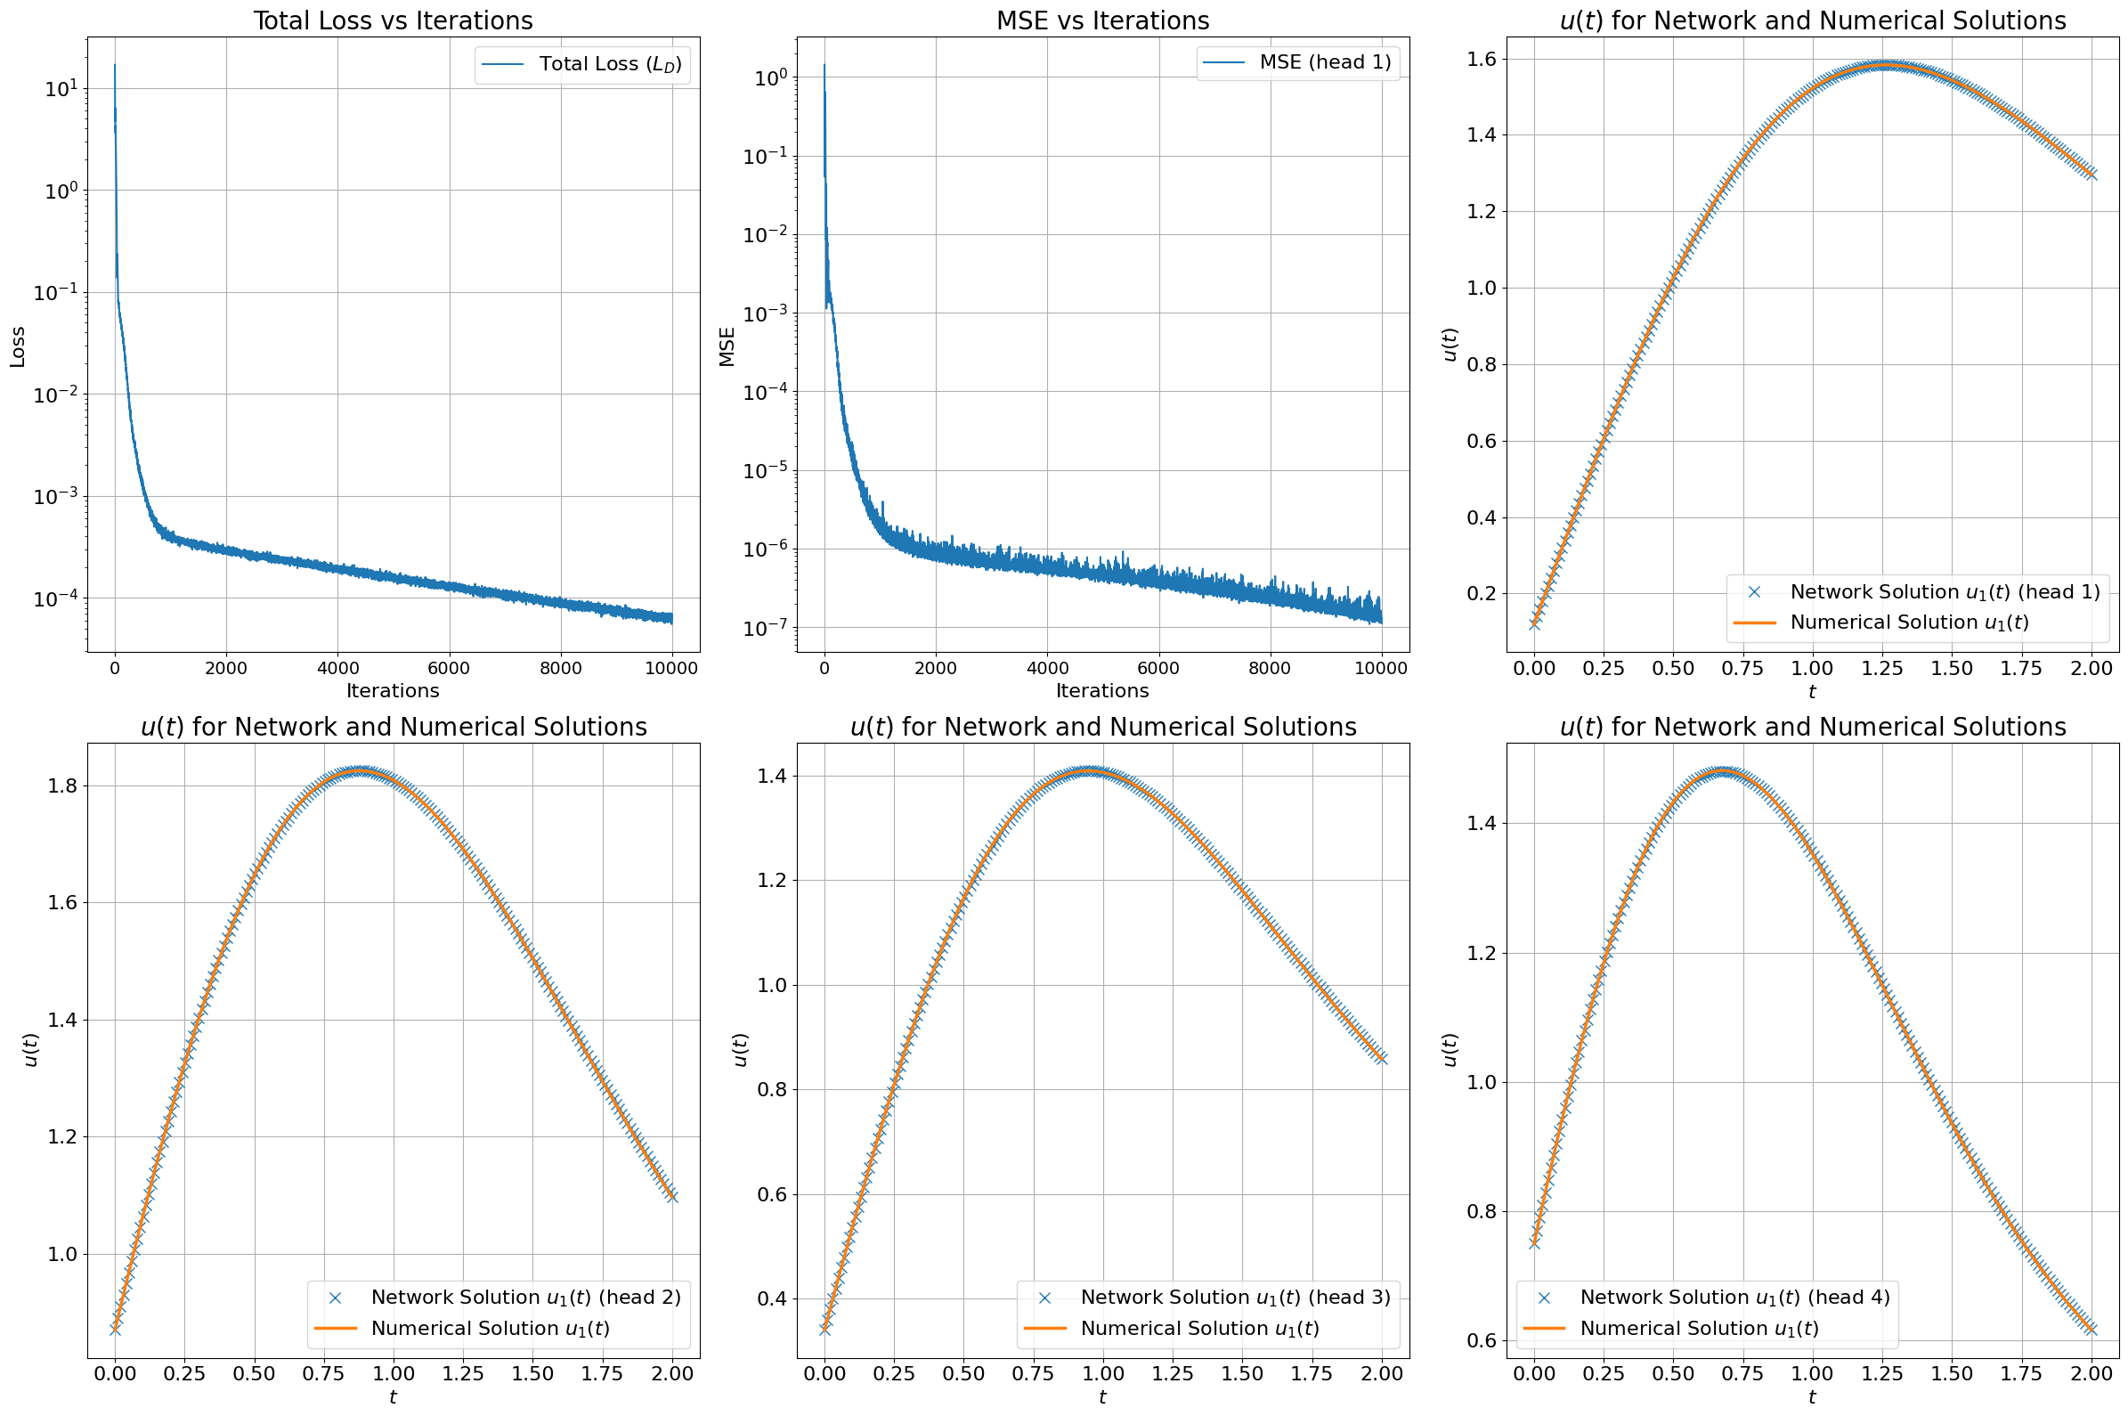
Example 2 - Non-constant Coefficient Equation: ODEs
After training, we examine the loss, mean squared error, and solution curves:
1
2
3
[1] Training Loss - differential equation residuals
[2] MSE - average of the square of the difference between network and numerical solutions
3
3
3
[3] Solution Curves - comparison between network versus numerical solutions from training
43

Slide 45
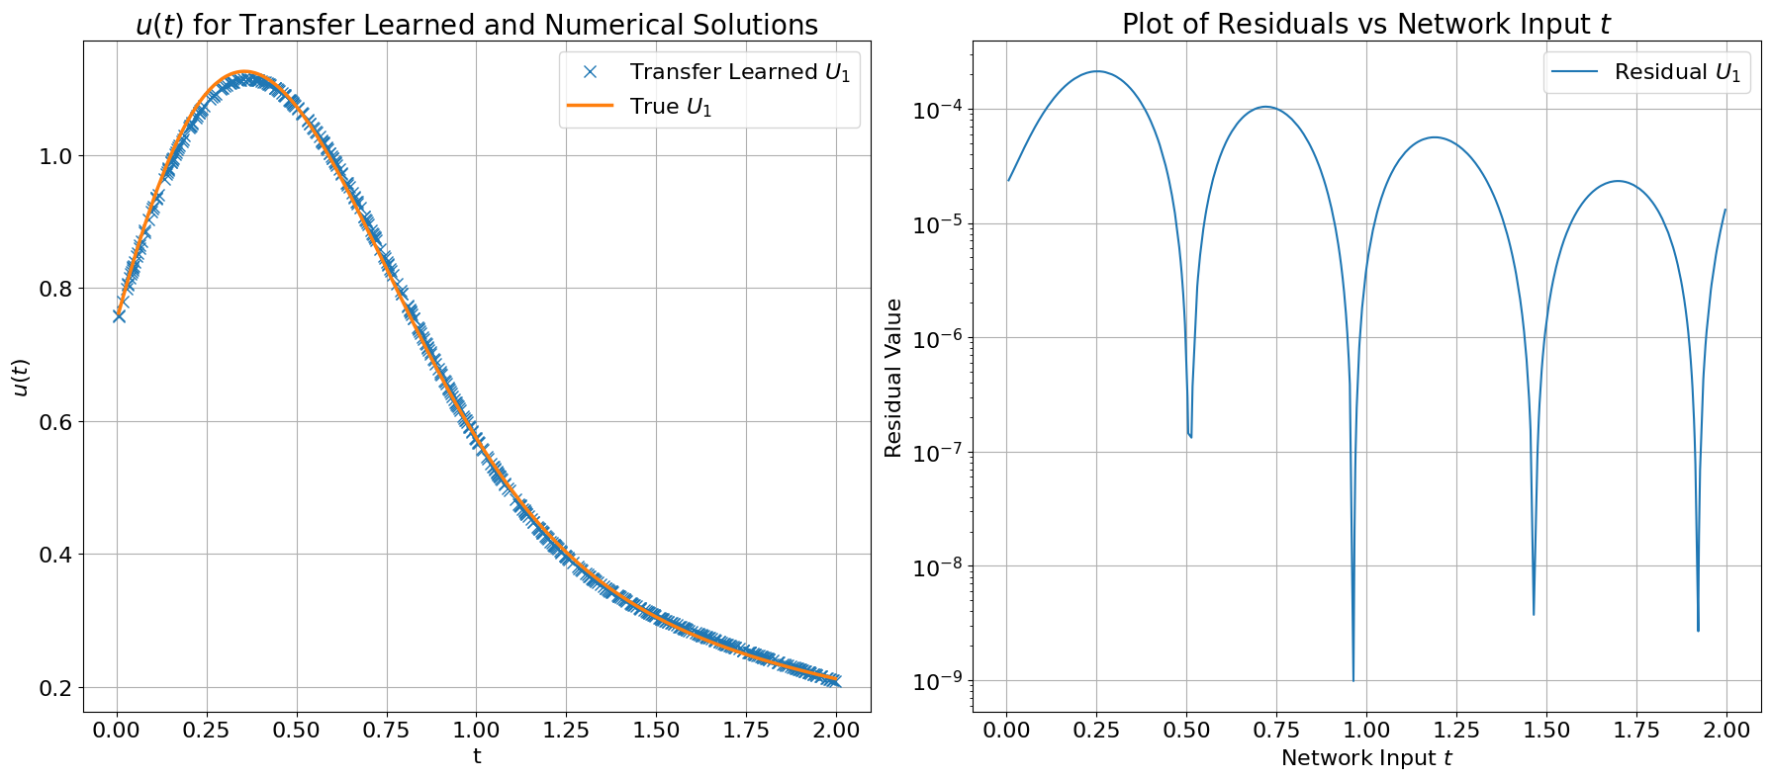

Example 2 - Non-constant Coefficient Equation: ODEs
Now, suppose we want to solve the equation with a new A of 5.0t
Recall the representation of W₀ for ODEs:$W0= M^{−1} (HT0 u0+\frac{1}{n}\sum_{t}{\dot{H}f+\frac{1}{n}\sum_{t}{HTATf)}}$
44

Slide 46
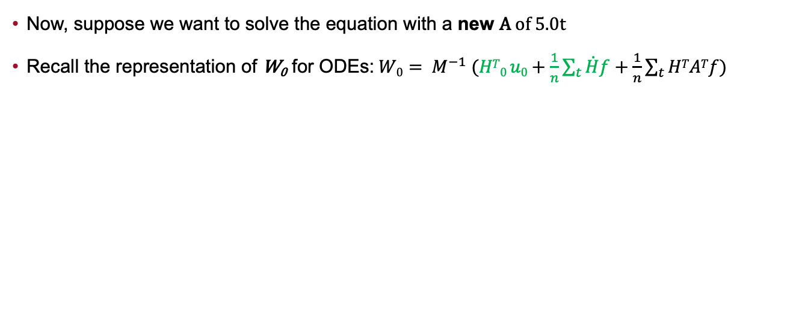
Example 2 - Non-constant Coefficient Equation: ODEs
Now, suppose we want to solve the equation with a new A of 5.0t
Recall the representation of W₀ for ODEs:$W0= M^{−1} (HT0 u0+\frac{1}{n}\sum_{t}{\dot{H}f+\frac{1}{n}\sum_{t}{HTATf)}}$
= Saved
= Change
45

Slide 47
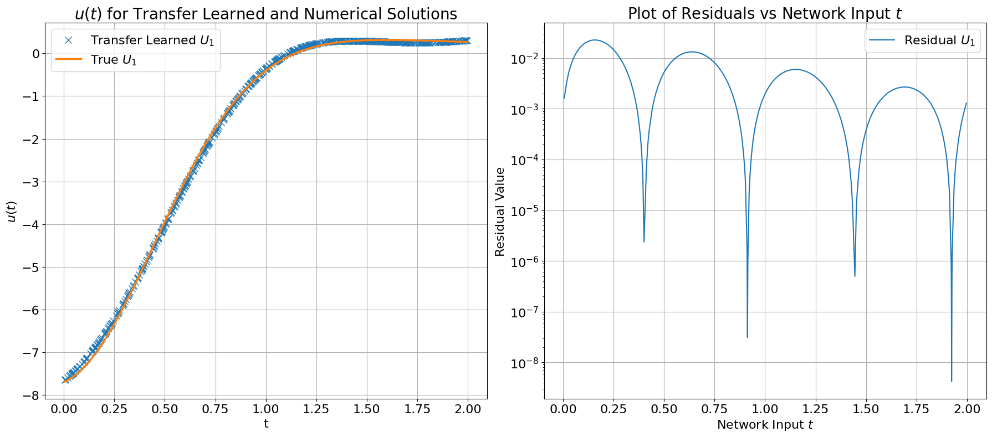

Example 2 - Non-constant Coefficient Equation: ODEs
Now, suppose we want to solve the equation with a new u₀ of -10.7 and a new A of 5.0t
Recall the representation of W₀ for ODEs:$W0= M^{−1} (HT0 u0+\frac{1}{n}\sum_{t}{\dot{H}f+\frac{1}{n}\sum_{t}{HTATf)}}$
46

Slide 48
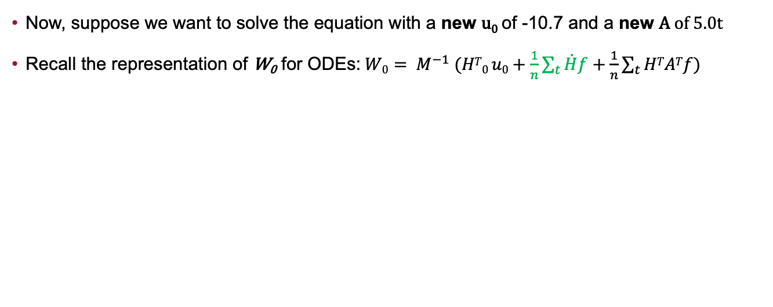
Example 2 - Non-constant Coefficient Equation: ODEs
Now, suppose we want to solve the equation with a new u₀ of -10.7 and a new A of 5.0t
Recall the representation of W₀ for ODEs:$W0= M^{−1} (HT0 u0+\frac{1}{n}\sum_{t}{\dot{H}f+\frac{1}{n}\sum_{t}{HTATf)}}$
= Saved
= Change
47

Slide 49
One-Shot Transfer Learning versus Runge Kutta: ODEs
To measure efficiency, we compare the run-times between our One-Shot Transfer Learning approach and a 4th order Runge-Kutta implementation
We show the times needed to calculate solutions after changing u₀ or A 1000 times:
Problem | One-Shot Transfer Learning |  | Runge-Kutta (4th order)
 | Change u₀ | Change A | Change u₀ | Change A
System of Coupled ODEs | 0.736 sec. | 4.416 sec. | 6.457 sec. | 4.987 sec.
Non-constant Coefficient ODE | 0.717 sec. | 7.439 sec. | 6.034 sec. | 4.112 sec.
48

Slide 50
Outline
Overview and Goals
Background and Motivation
Training & Transfer Learning Components
Ordinary Differential Equations
Partial Differential Equations
Performing One-Shot Transfer Learning
Ordinary Differential Equations
Partial Differential Equations
Results
Ordinary Differential Equations
Partial Differential Equations
Limitations
Future Work
Conclusion
49

Slide 51


Example 3 - System of Two Equations: PDEs
Consider a system of two PDEs with $u1(x1, 0)$ = v₁x₁ and $u2(x1, 0)$ = v₂x₁ :
$$c1\frac{∂u1}{∂x1}+c2\frac{∂u1}{∂x2}=f1$$
$$c3\frac{∂u2}{∂x1}+c4\frac{∂u2}{∂x2}=f2$$
Train for 40000 iterations with “4 heads” and the following G, u₀, and f combinations:
Head # | 1 | 2 | 3 | 4
G : $\left[\begin{matrix}c1 & c2 \\ c3 & c4\end{matrix}\right]$ | $$\left[\begin{matrix}1.0 & 4.0 \\ 1.0 & 9.0\end{matrix}\right]$$ | $$\left[\begin{matrix}2.3 & 3.0 \\ 4.1 & 5.7\end{matrix}\right]$$ | $$\left[\begin{matrix}1.2 & 4.3 \\ 1.5 & 6.3\end{matrix}\right]$$ | $$\left[\begin{matrix}1.1 & 3.4 \\ 2.5 & 8.3\end{matrix}\right]$$
u₀ : [v₁x₁, v₂x₁] | [2.0x₁, 3.0x₁] | [3.1x₁, 4.2x₁] | [0.3x₁, 0.1x₁] | [1.2x₁, 5.3x₁]
f : [f₁, f₂] | [0.0, 0.0] | [0.0, 0.0] | [0.0, 0.0] | [0.0, 0.0]
50

Slide 52

Example 3 - System of Two Equations: PDEs
After training, we examine the loss, mean squared error, and solution curves:
1
2
3
[1] Training Loss - differential equation residuals
[2] MSE - average of the square of the difference between network and analytical solutions
[3] Solution Curves - comparison between network versus analytical solutions from training
3
3
3
51

Slide 53


Example 3 - System of Two Equations: PDEs
Suppose we want to solve the system with a new u₀ of [2.0x₁, -1.1x₁] and a new G of $\left[\begin{matrix}3.2 & 5.1 \\ 1.4 & 7.3\end{matrix}\right]$
Recall the representation of W₀ for PDEs:$W0= M^{−1} (\frac{1}{n}\sum_{x}{H0Tu0}+\frac{1}{n}\sum_{x}{STf+\frac{1}{n}\sum_{x}{HTATf)}}$
52

Slide 54

Example 3 - System of Two Equations: PDEs
Suppose we want to solve the system with a new u₀ of [2.0x₁, -1.1x₁] and a new G of $\left[\begin{matrix}3.2 & 5.1 \\ 1.4 & 7.3\end{matrix}\right]$
Recall the representation of W₀ for PDEs:$W0= M^{−1} (\frac{1}{n}\sum_{x}{H0Tu0}+\frac{1}{n}\sum_{x}{STf+\frac{1}{n}\sum_{x}{HTATf)}}$
= Saved
= Change
53

Slide 55
Outline
Overview and Goals
Background and Motivation
Training & Transfer Learning Components
Ordinary Differential Equations
Partial Differential Equations
Performing One-Shot Transfer Learning
Ordinary Differential Equations
Partial Differential Equations
Results
Ordinary Differential Equations
Partial Differential Equations
Limitations
Future Work
Conclusion
54

Slide 56
Limitations
In the case of nonlinear differential equations, a difficult derivation of W₀ arises
No closed-form solution in most cases
Our approach can be computationally intensive due to the initial network training across multiple heads
Richer latent space → more heads
One-Shot Transfer Learning does not immediately yield solutions with 0 error
Trade-off between accuracy vs speed
Generalization outside training domain is not straightforward
55

Slide 57
Outline
Overview and Goals
Background and Motivation
Training & Transfer Learning Components
Ordinary Differential Equations
Partial Differential Equations
Performing One-Shot Transfer Learning
Ordinary Differential Equations
Partial Differential Equations
Results
Ordinary Differential Equations
Partial Differential Equations
Limitations
Future Work
Conclusion
56

Slide 58
Future Work
Apply network training and transfer learning methodology to a larger scale, real-world problem
Particles in a box
Enhance and implement the training and transfer learning code into a neural network differential equation library
NeuroDiffEq
Perform transfer learning across different time domains
Expand the existing work to handle nonlinear differential equations via a perturbation approach
Solve Burgers’ or Hamilton equations
57

Slide 59
Outline
Overview and Goals
Background and Motivation
Training & Transfer Learning Components
Ordinary Differential Equations
Partial Differential Equations
Performing One-Shot Transfer Learning
Ordinary Differential Equations
Partial Differential Equations
Results
Ordinary Differential Equations
Partial Differential Equations
Limitations
Future Work
Conclusion
58

Slide 60
Conclusion
Presented a robust method to train PINNs on vectorized representations of linear ODEs and PDEs
Outlined how a multi-headed training process can be used to extract a latent space representation H of the equations
Derived a closed-form representation of generalizable network weights W₀ for both linear ODEs and PDEs
Showed how H and W₀ can be used to transfer learn solutions across an assortment of differential equation examples with no additional training
59

Slide 61
Thank You

Slide 62
Questions?

Slide 63
Nonlinear Differential Equations: Perturbation approach

Slide 64


Transfer Learning: The nonlinear case
$$Du+u+εu^{2}−f\left(t\right)=0$$
Perturbation approach:
$$u=u_{o}+εu_{1}+ε^{2}u_{2}+…$$
Substitute this to the DE, yields
D${(u}_{o}+εu_{1}+ε^{2}u_{2}+…$)+ $u_{o}+εu_{1}+ε^{2}u_{2}+…+ε{\left(u_{o}+εu_{1}+ε^{2}u_{2}+…\right)}^{2}−f\left(t\right)=0$

Slide 65

Transfer Learning: The nonlinear case
D${(u}_{o}+εu_{1}+ε^{2}u_{2}+…$)+ $u_{o}+εu_{1}+ε^{2}u_{2}+…+ε{\left(u_{o}+εu_{1}+ε^{2}u_{2}+…\right)}^{2}−f\left(t\right)=0$
Collecting terms of equal power of $ε$

Slide 66

Transfer Learning: The nonlinear case
D${(u}_{o}+εu_{1}+ε^{2}u_{2}+…$)+ $u_{o}+εu_{1}+ε^{2}u_{2}+…+ε{\left(u_{o}+εu_{1}+ε^{2}u_{2}+…\right)}^{2}−f\left(t\right)=0$
Collecting terms of equal power of $ε$
D$u_{o}+u_{o}−f\left(t\right)=0$

Slide 67

Transfer Learning: The nonlinear case
D${(u}_{o}+εu_{1}+ε^{2}u_{2}+…$)+ $u_{o}+εu_{1}+ε^{2}u_{2}+…+ε{\left(u_{o}+εu_{1}+ε^{2}u_{2}+…\right)}^{2}−f\left(t\right)=0$
Collecting terms of equal power of $ε$
D$u_{o}+u_{o}−f\left(t\right)=0$
D$u_{1}+u_{1}+u_{o}^{2}=0$

Slide 68

Transfer Learning: The nonlinear case
D${(u}_{o}+εu_{1}+ε^{2}u_{2}+…$)+ $u_{o}+εu_{1}+ε^{2}u_{2}+…+ε{\left(u_{o}+εu_{1}+ε^{2}u_{2}+…\right)}^{2}−f\left(t\right)=0$
Collecting terms of equal power of $ε$
D$u_{o}+u_{o}−f\left(t\right)=0$
D$u_{1}+u_{1}+u_{o}^{2}=0$
D$u_{2}+u_{2}+{2u}_{0}u_{1}=0$

Slide 69
Transfer Learning: The nonlinear case
D${(u}_{o}+εu_{1}+ε^{2}u_{2}+…$)+ $u_{o}+εu_{1}+ε^{2}u_{2}+…+ε{\left(u_{o}+εu_{1}+ε^{2}u_{2}+…\right)}^{2}−f\left(t\right)=0$
Collecting terms of equal power of $ε$
D$u_{o}+u_{o}−f\left(t\right)=0$
D$u_{1}+u_{1}+u_{o}^{2}=0$
D$u_{2}+u_{2}+{2u}_{0}u_{1}=0$
…

Slide 70





Transfer Learning: The nonlinear case
D${(u}_{o}+εu_{1}+ε^{2}u_{2}+…$)+ $u_{o}+εu_{1}+ε^{2}u_{2}+…+ε{\left(u_{o}+εu_{1}+ε^{2}u_{2}+…\right)}^{2}−f\left(t\right)=0$
Collecting terms of equal power of $ε$
D$u_{o}+u_{o}−f\left(t\right)=0$
D$u_{1}+u_{1}+u_{o}^{2}=0$
D$u_{1}+u_{1}+f′(t)=0$
Iteratively solve this
D$u_{2}+u_{2}+{2u}_{0}u_{1}=0$
D$u_{2}+u_{2}+f”(t)=0$
…

Slide 71











Transfer Learning IV: Nonlinear DE. Perturbation method
NN: W
$$W_{o}$$
$$u_{0}=W_{o}H$$
t
H
$$W_{1}$$
$$u_{1}=W_{1}H$$
$$W_{2}$$
$$u_{2}=W_{2}H$$
…
…
D$u_{o}+u_{o}−f\left(t\right)=0$
D$u_{1}+u_{1}+u_{o}^{2}=0$
D$u_{1}+u_{1}+f′(t)=0$
D$u_{2}+u_{2}+{2u}_{0}u_{1}=0$
D$u_{2}+u_{2}+f′′(t)=0$
…
…

